Slide 1
Fundamentals of Hardwired control
In the past, hardwired control unit was very difficult to design as its engineering cost is very high.
Presently, the emphasis of computer design is on the performance, therefore hardwired control is chosen.

Slide 2
Fundamentals of Hardwired control
controller of a hardwired control unit is viewed as a sequential logic circuit that implements microoperations using a combinational circuit.
The inputs are from the microperation counter, instruction register and status register, which are transformed into a set of outputs that are the control signals.

Slide 3
Hardwired Processor
IR
Instruction Decoder
I₁
I₂
I_{n}
Control step counter
Encoder/Decoder
Inputs from system bus
Clock
Status and Condition Flags
Control Signals

Slide 4
Hardwired Processor
The control unit gets opcodes from the instructions and will perform different actions based on the combinations of control signals.
Starting with description of the behavior of the control unit, state diagram of micro-operations is constructed.
From state diagram, hardware realization can be constructed.

Slide 5
This concept can be explained by taking an example.
Some common statements of a program are described in Figure 4.3:

Slide 6
:LOOP: if COND 1 = true then ADD A,B Else MUL A,B; if COND 2 = true then go to OUTPUT Else LOOP; OUTPUT
Figure 4.3 Example statements in a program

Slide 7
The state-table format for the above statements is shown in Figure 4.4
TABLE 2
Current State | Current Input | Next State | Current Outputs Function Storage
ADR1 ADR1 ADR2 ADR2 | COND1 = 1 COND1 = 0 COND2 = 1 COND2 = 0 | ADR2 ADR2 ADR3 ADR1 | ADD … MUL … … … … …
Figure 4.4 State-Table format of statements of Figure 4.3
m

Slide 8
Designing Hardwired Control Unit
From state table, hardware realization can be constructed.
Any sequential circuit, which can implement a state machine, can be constructed from combination circuit with feedback

Slide 9
design Processor computing Greatest Common Divisor (GCD)
To find GCD of two numbers X and Y,
the smaller of the two numbers is subtracted from the bigger one.
process is repeated until we obtain the number that divides the other.
The procedure to perform the GCD is described in Figure 4.5.

Slide 10
Figure 4.5 State-Table format of statements of Figure 4.4
m
GCD(in: X,Y; out: Z);
Register XR, YR, TEMPR;
XR:=X; {Input data}
YR:=Y;
While XR>0 do begin
If XR ≤YR then begin {Swap XR and YR)
TEMPR:=YR;
YR:=XR;
XR:=TEMPR; end
XR:=XR-YR {Subtract YR from XR}
End
Z:=YR (Output the result)
End. GCD;

Slide 11
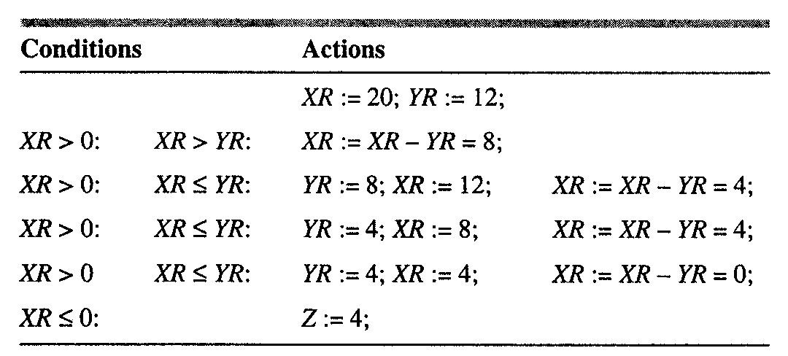
state-table description of this algorithm is given in Figure 4.5, which gives the steps involved in finding the GCD of two numbers.
For example, with X=20 and Y=12, the GCD algorithm proceeds as in Figure 4.3.

Slide 12
From the analysis of Figure 4.6, it can be judged that the datapath of this processor should have registers to store the variables XR and YR.
To perform subtraction and comparison, two functional units are needed.
To route the data on the relevant datapath at the appropriate time, a multiplexer is needed.
swap operation X:=Y, Y:=X can be done simultaneously in one clock cycle

Slide 13
The inputs to the control unit are asynchronous reset signal, two comparison signals to compare if XR is equal to YR, or whether it is equal to YR (XR≥YR) and (XR>0), and the clock signal.
Control Signals needed by the control unit are Load, Select, Swap, Subtract.

Slide 14
different states of the processor are defined based on the algorithm of the GCD
S₀ = 00 begin
S₁ = 01 swap
S₂ = 10 subtract
S₃ = 11 end

Slide 15
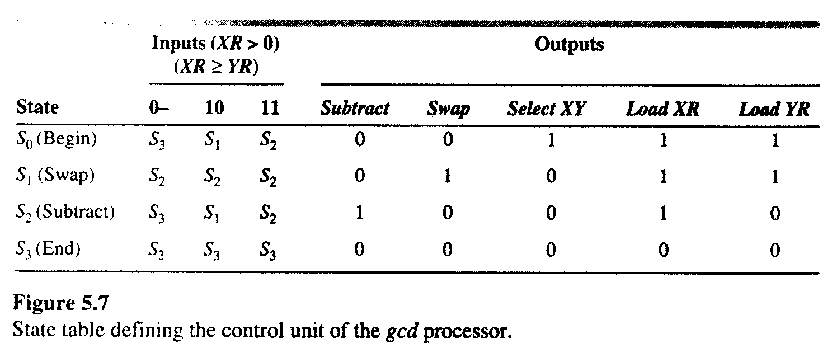
TABLE 3 State Table for the GCD processor

Slide 16
Using TABLE 3, an excitation-table is constructed listing the binary values of various variables at different times.
This is shown in TABLE 4.
Characteristic equation of D flip-flop is (t+1) = (t). Thus, for different values of D₁ and D₂, values of and can be defined. This excitation table is depicted in TABLE 4.

Slide 17
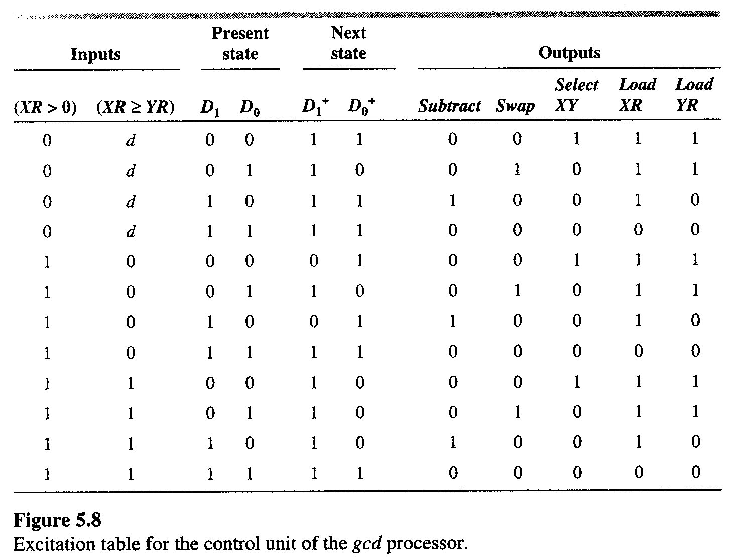
S₀ = 00, S₁ = 01, S₂ = 10 and S₃ = 11

Slide 18
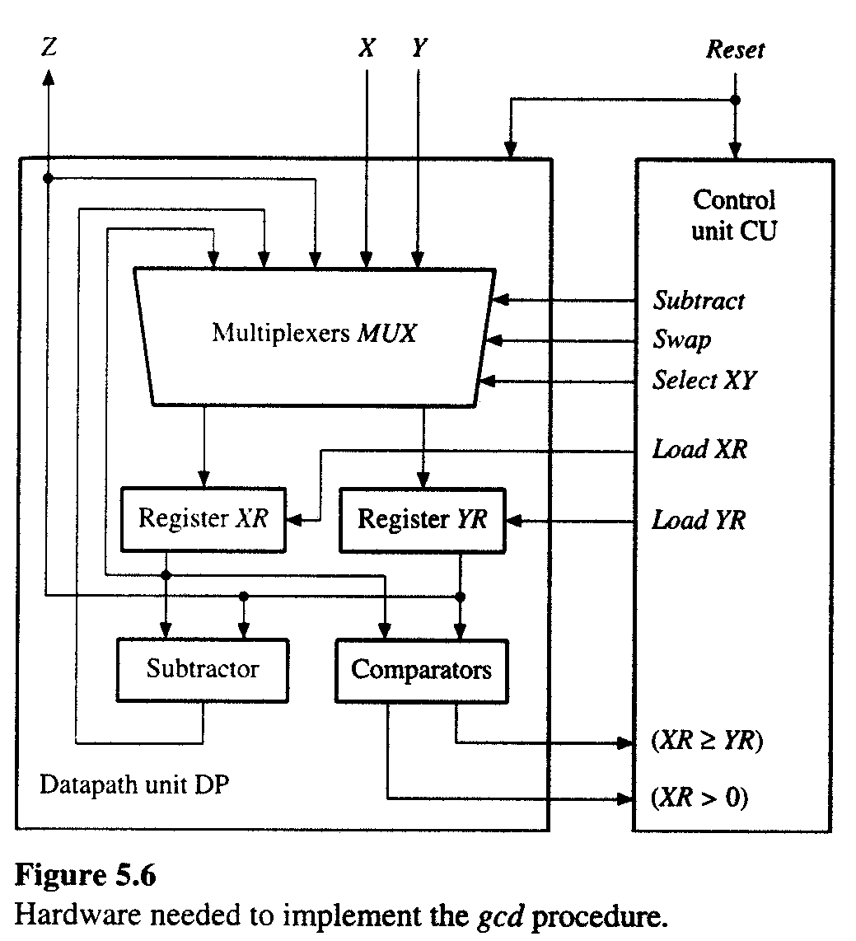

Slide 19
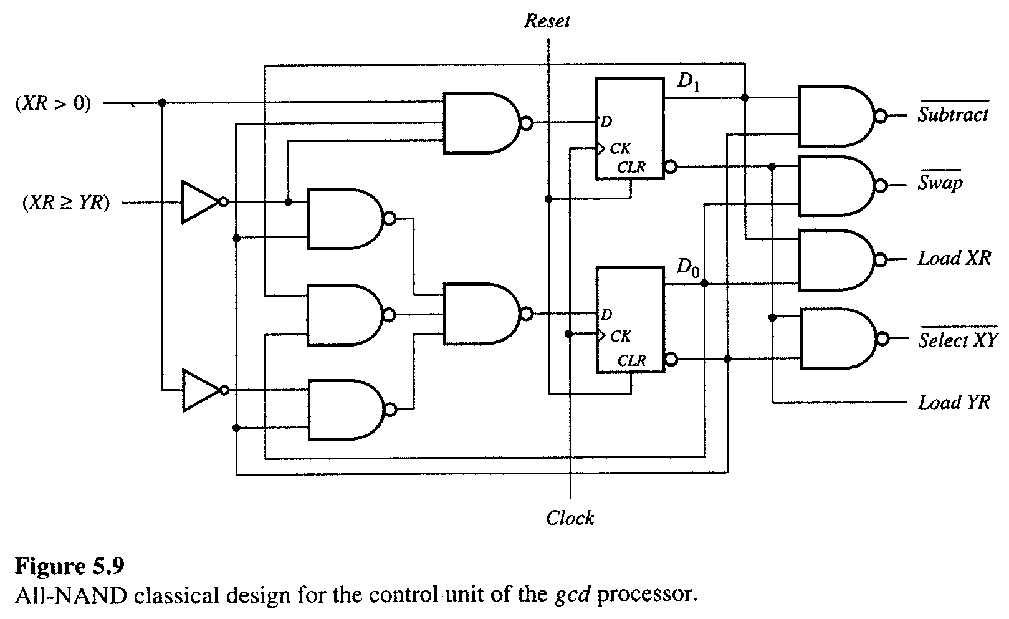

Slide 20
(5.9)
(5.10)
(5.11)

Slide 22
